Slide 1
CSYE 6200 Final Project presentation
RPG Game: Unknown Journey
Unknown:
Jiamin Jiang, jiang.jiam@northeastern.edu
Jialun Tang, tang.jial@northeastern.edu
Wencan Yang, yang.wenc@northeastern.edu

Slide 2
Background
Lots of games are to complex
Tired when facing the same content
Take too long to finish a game
Not intellectually stimulating

Slide 3
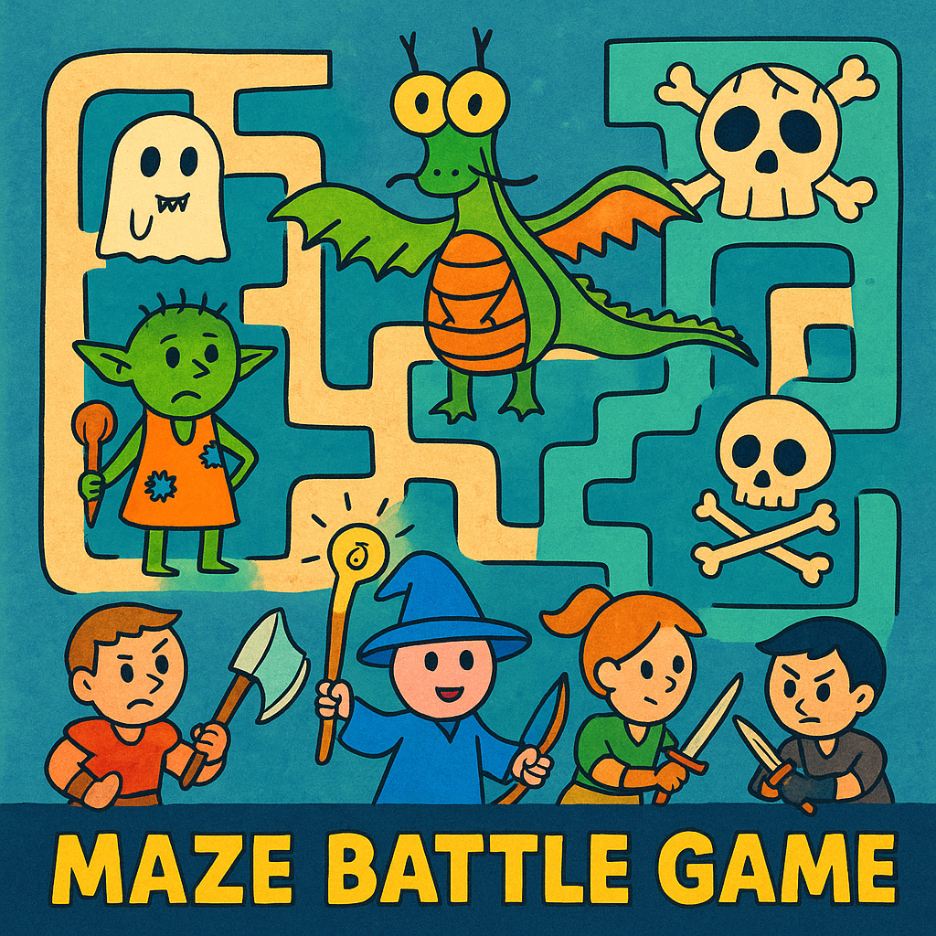
Problem Description
Project Overview
This is a JavaFX Maze RPG game where the player explores a multi-path maze.
Along the journey, the player may encounter monsters, rewards, and traps.
The final objective is to defeat the Boss and reach the exit.

Slide 4
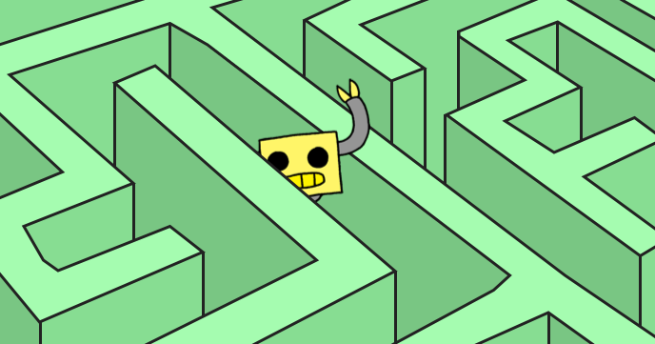
Introduction
Core Gameplay
Multiple playable characters, each with unique stats and abilities.
Every class offers a different playstyle and strategy.
Maze features both simple fixed layouts and fully randomized modes for replayability.

Slide 5
Analysis
Maze Structure and Movement Analysis
Main path, wrong paths, junctions, and traps.
DEX-based random step generation
Step-by-step movement
Randomness data

Slide 6
Analysis
Event Priority Analysis
Reward / Trap / Enemy / Boss
Exclusive events
Priority ordering
Interrupt rules

Slide 7
Analysis
Item & Inventory Analysis
Instant items vs consumables
HP/MP sync
Function of cloaks

Slide 8
Design - GUI Navigation Flow
Multi-FXML structure
switchScene() system
State persistence
Dynamic maze GUIs
Battle / Reward / Trap screens

Slide 9
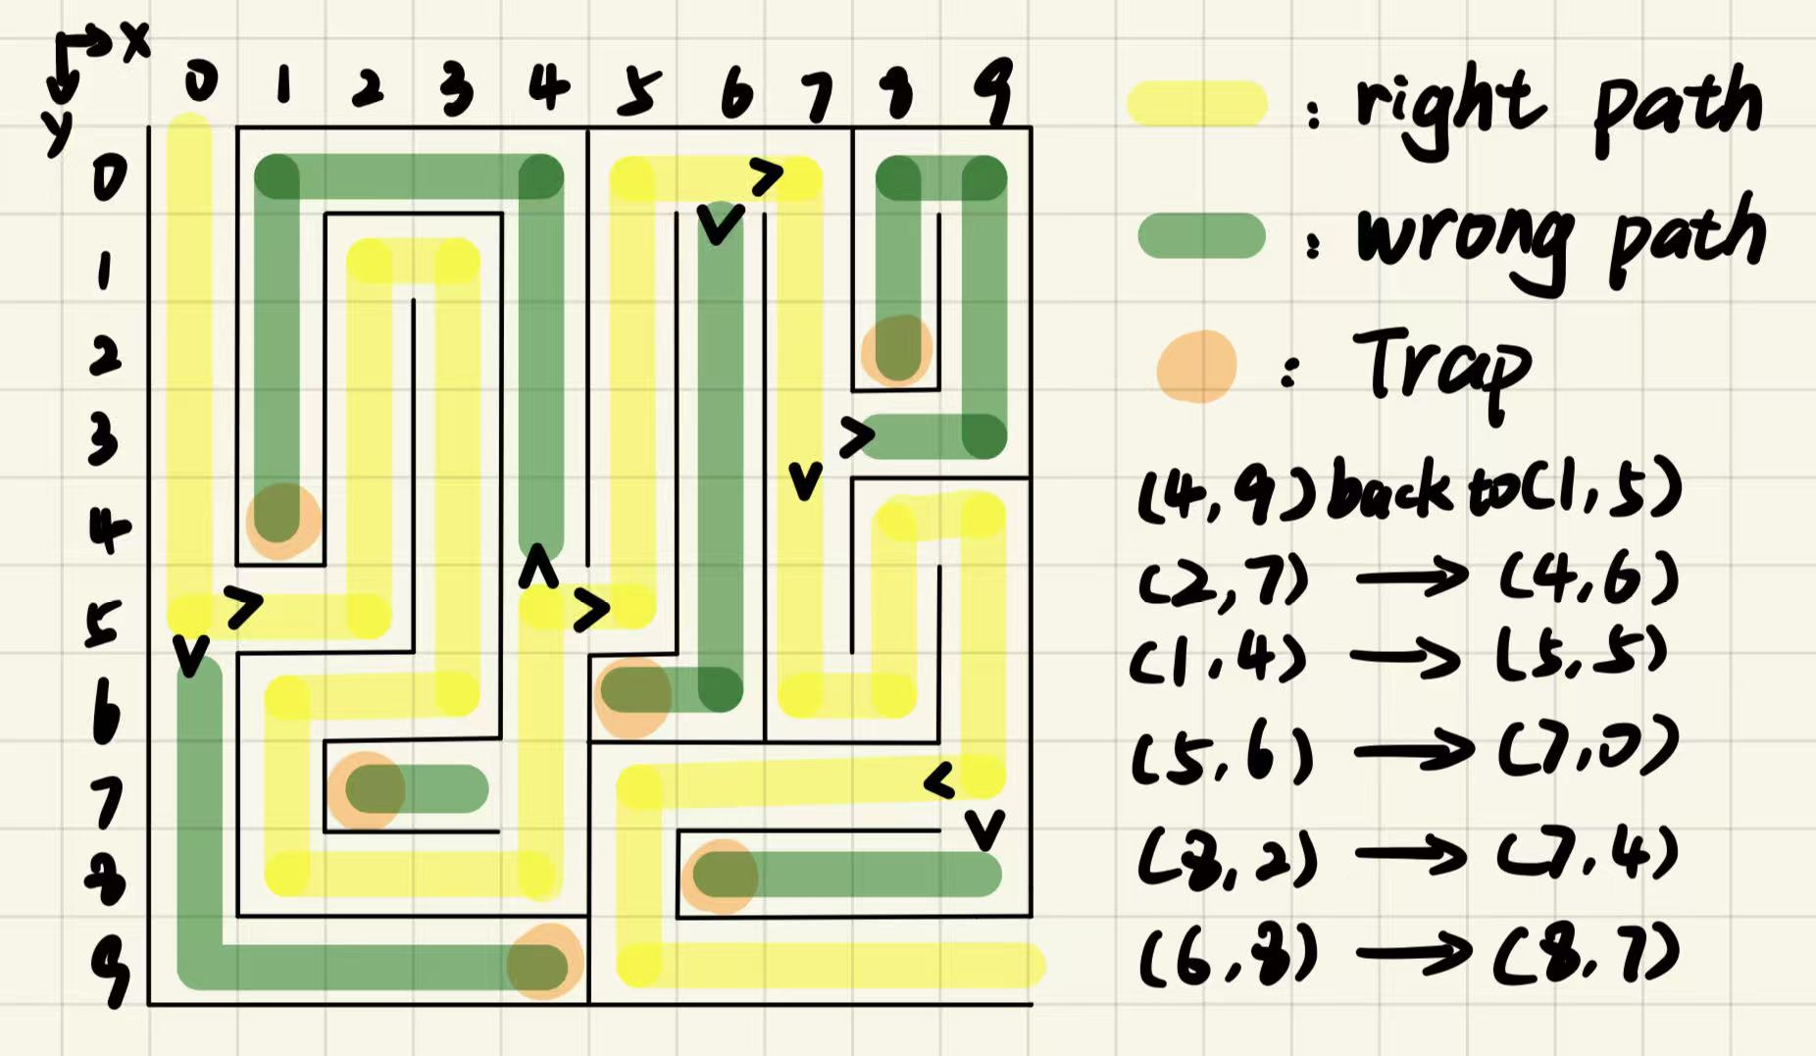
Design - Sample
10×10 layout
Main route (yellow)
Wrong routes (green)
Six trap teleports
Junction types

Slide 10
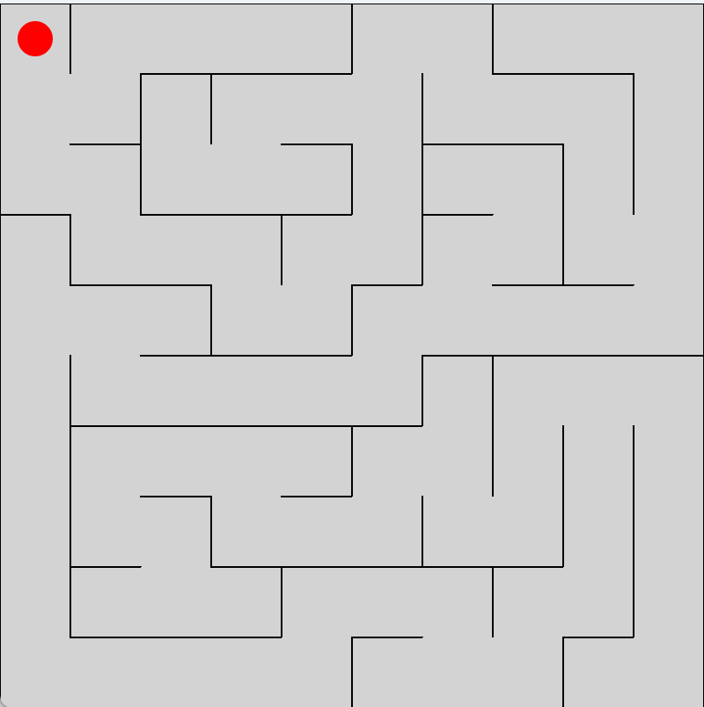
Design - Random
Randomly generate
A block will try to find
a unconnect neighbor
and ask it to do the same.
(DFS)

Slide 11
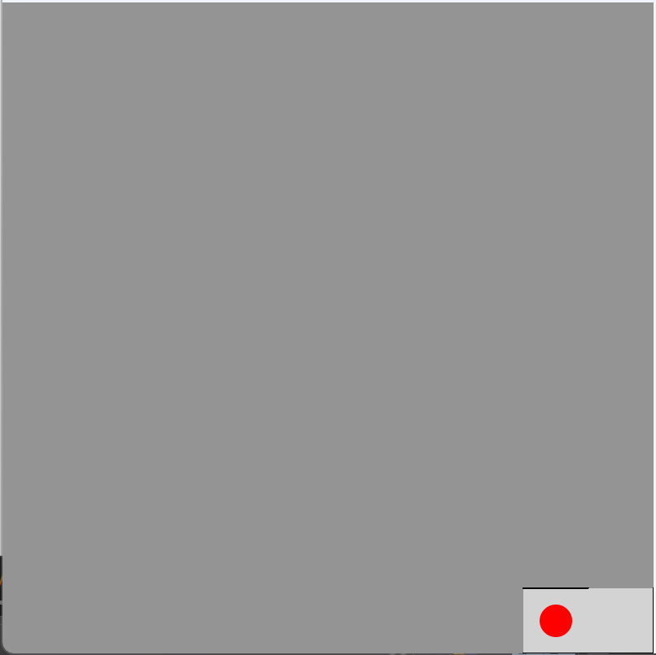
Design - Random
Map Controller updates
the position of the player
whenever the player moves
The player can only see
blocks that has bennvisited.
(In fog mode)

Slide 12
Design - Random
The possibility will increase when
player keeps missing monsters
or rewards.
Once a monster or a reward
is encounter, the possibility
resets.

Slide 13


Implementation
For this project, we use
eclipse and Scene Builder
to complete the coding part
and the UI design.

Slide 14
Requirements
Class Definition
Inheritance/Polymorphism
Abstract Classes/Interfaces
Recursion
Set/Maps

Slide 15
Results
• The random-encounter probability works correctly and resets after each encounter.
• Character stats and skills function as expected during gameplay.
• Path-choosing buttons trigger maze progression smoothly.
• All scenes switch properly and the UI runs without errors.

Slide 16
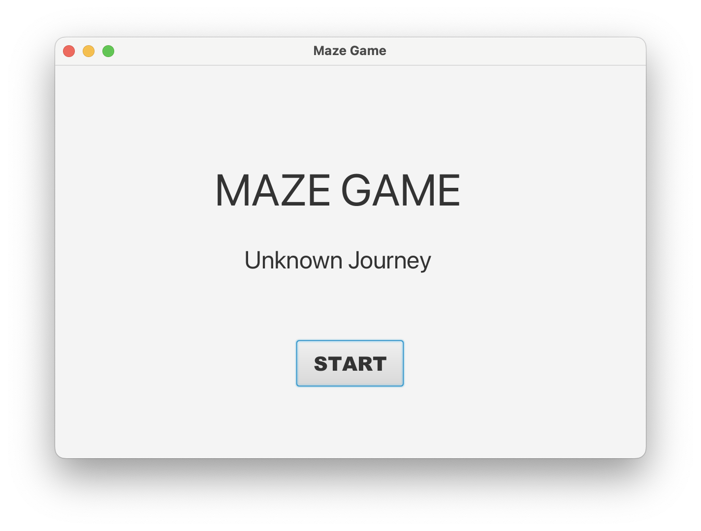
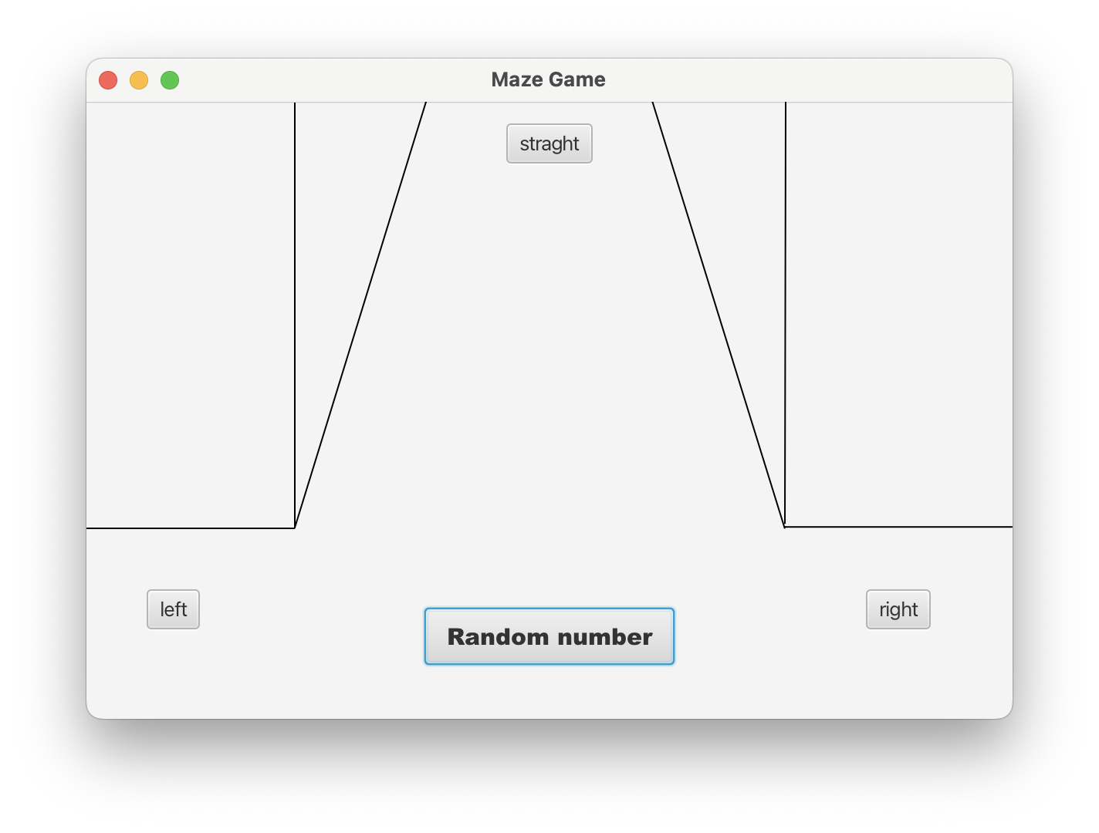
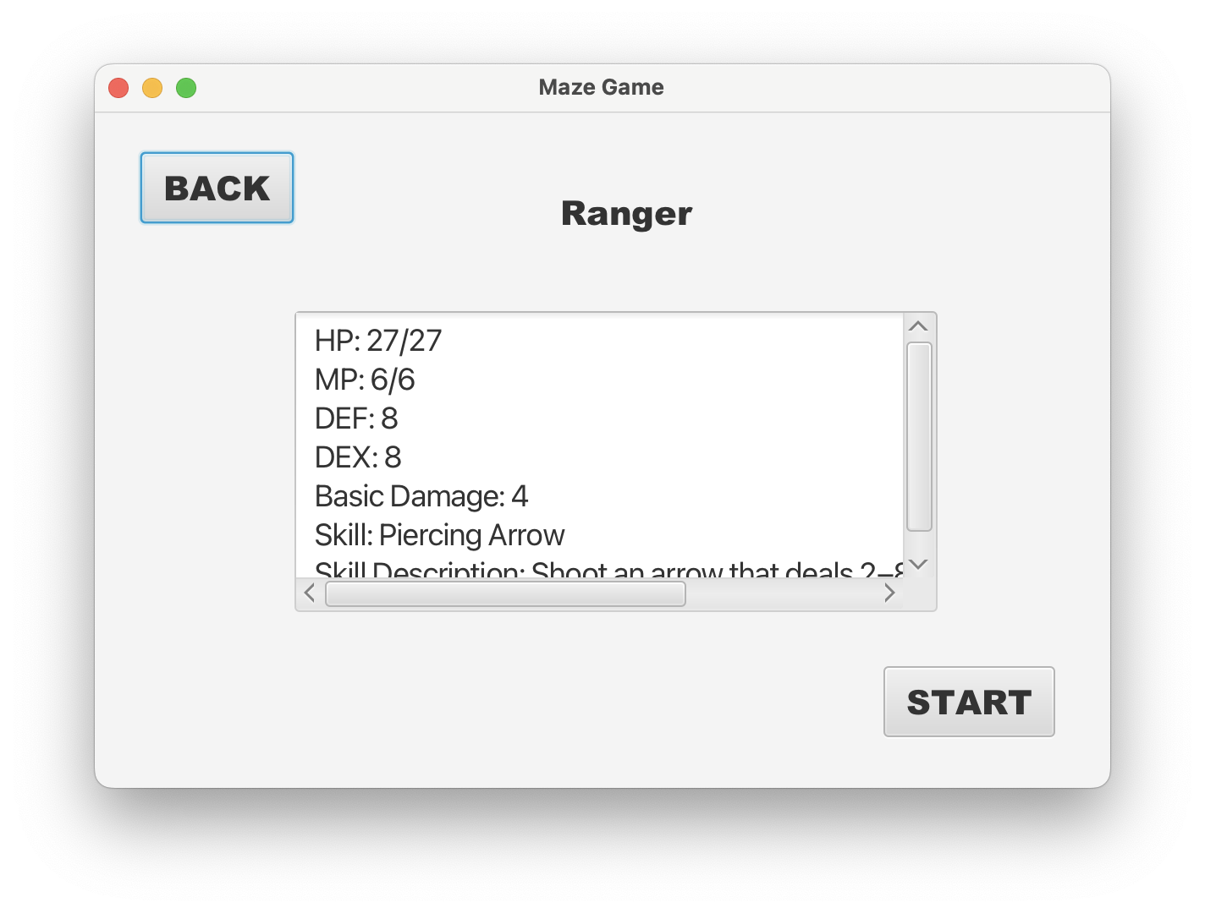
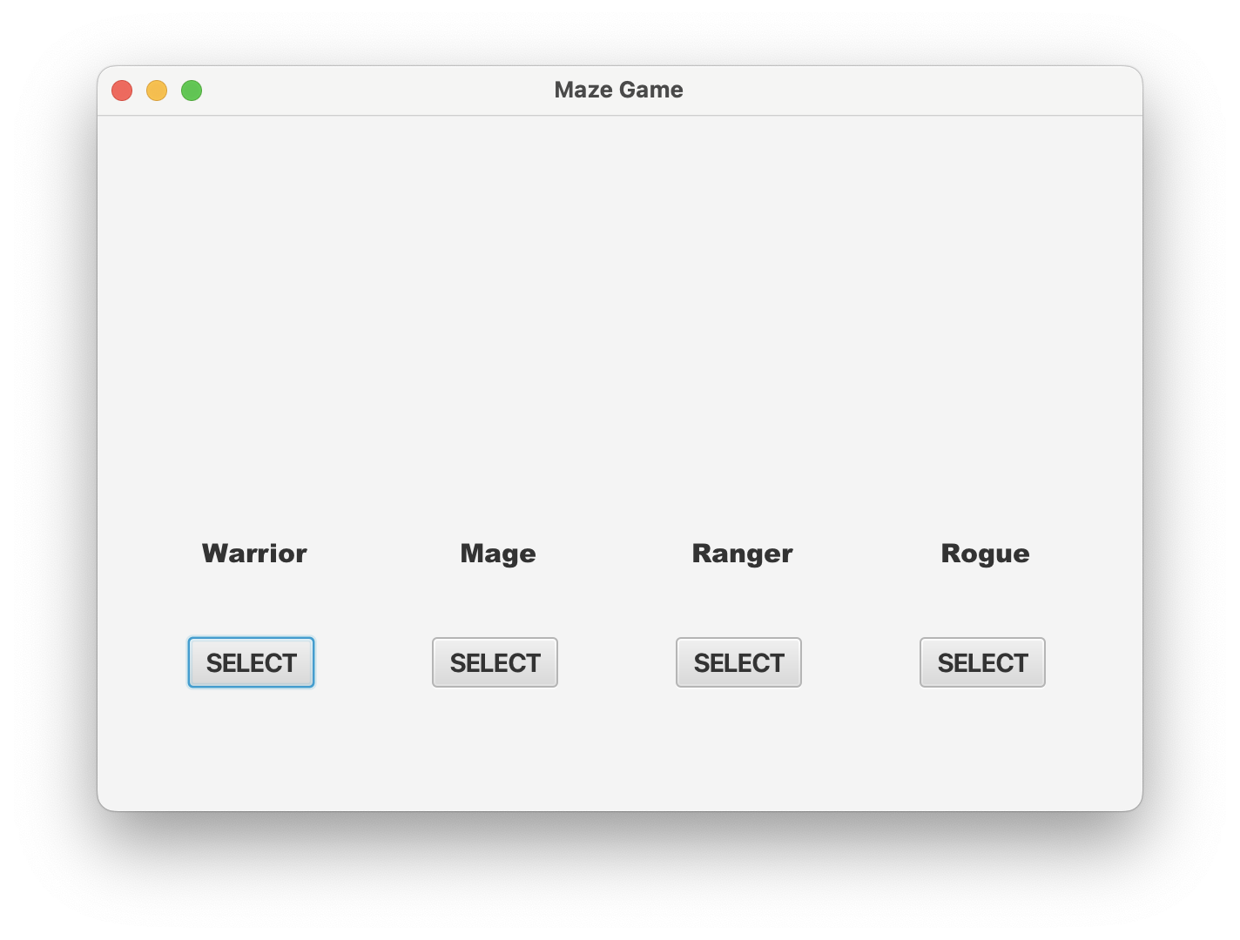

Slide 17
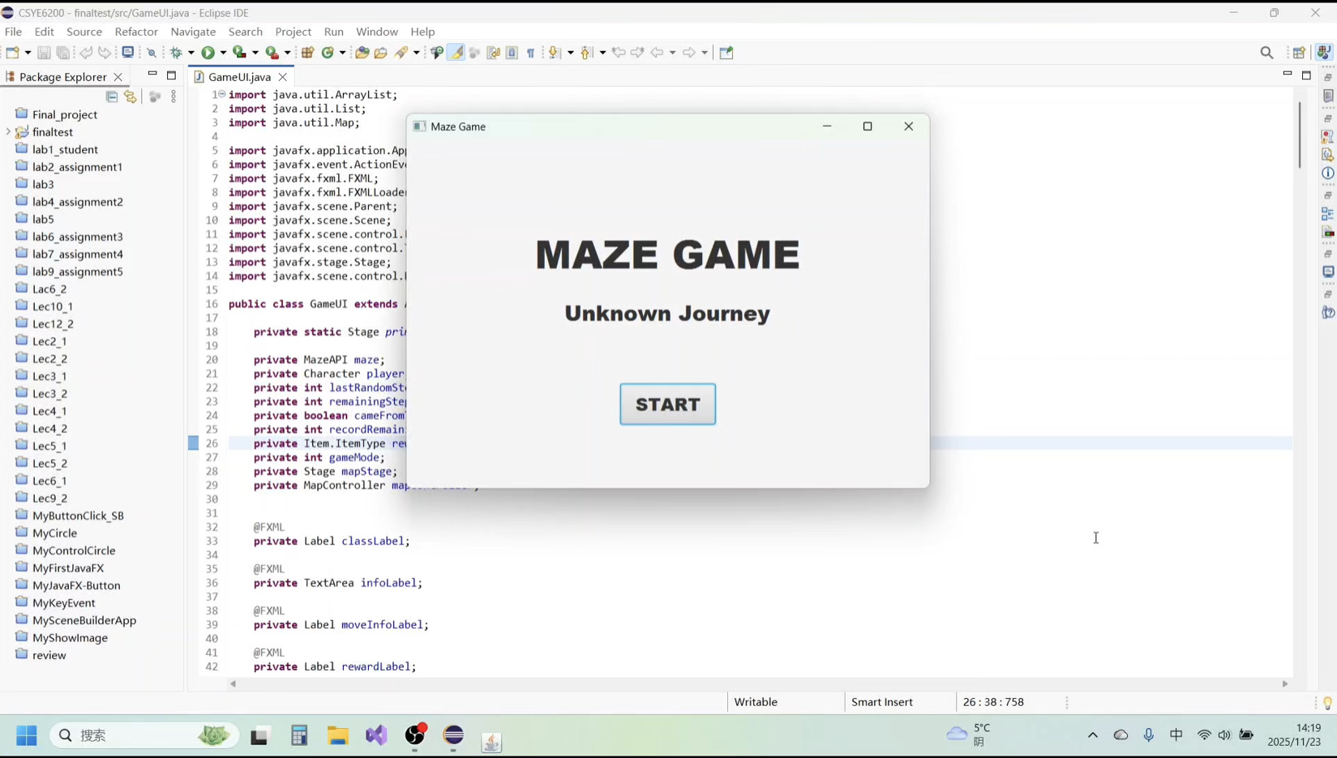
This is a simple demo for the game.

Slide 18

Discussion
Complexity in Item & Inventory Integration
Stackable vs One-Time Items
Unsynchronized Inventory State
Added backpack for consumable itemsb
One-Time items NOT consume a turn

Slide 19

Discussion
Dynamic GUI Switching at Maze Junctions
Multi-Path Choices
Position-Based GUI Mismatch
GUI Selection by Path Count
Unified Scene Switching Logic

Slide 20
Discussion
Player facing
Choices at folk
First-person perspective
Decided by history
When trapped by dead end
Choice will be closed

Slide 21
Conclusions
The game successfully integrates maze exploration with basic RPG combat and item mechanics.
Major issues—such as scene switching and event logic—were fixed through a unified control structure.
The final version runs stably and supports both fixed and fully randomized maze modes.

Slide 22

Future Work
Add more monsters, classes, and abilities.
Improve GUI transitions and visual feedback.
Enhance maze generation for greater variety.
Introduce a feature that allows players to customize item or character proportions.
Save and load

Slide 23
Job assignments
Jiamin Jiang: Character System、Enemy System
Sample Maze Logic、Core Game GUI
Jialun Tang: Item System、Battle System、Battle GUI
Wencan Yang: Random Maze Flow
Random Maze GUI
Project Integration

Slide 24
Thank you for listening
Are there any problems?

